Slide 1
Breaking open the Cage: the story behind your favorite (and only) Wayland kiosk

Slide 2
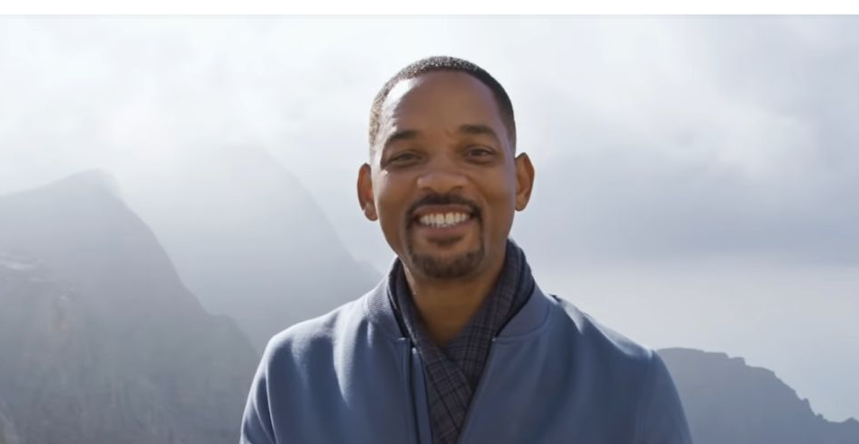
Rewind Time
Notes:
It is a project I started back in 2018 in a blissful pre-pandemic era, when I decided to build my own home automation system.
Why? I was working on my MSc thesis and was bored with the formal programming so I just wanted to build something. Not only would I be able to see the fruits of my labor (*click* light on, *click* light off), it would also be multiple smaller projects. Ideal to spend a few afternoons.
But taking off-the-shelf components for an endeavour like this would be too easy, or so I thought. I like computering and I consider myself a capable engineer, so I went for the challenge and decided to do it on my own.

Slide 3
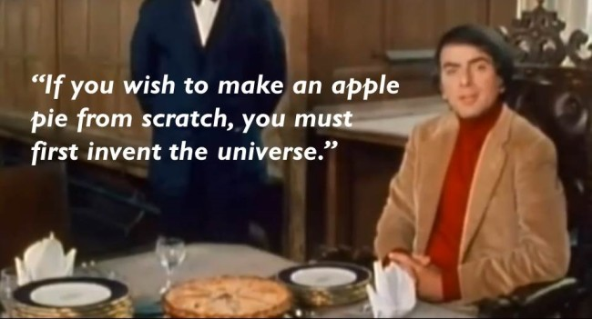
– Carl Sagan
Notes:
In the words of Carl Sagan: "If you wish to make an apple pie from scratch, you must first invent the universe.
And so I set out to build the whole stack myself: a custom Linux distribution, a custom window manager, a custom browser to display hass.io's page only…
I have since moved three times and my home is still not automated, but I do have a kickass prototype embedded Linux distribution and Cage... my own Wayland compositor!
It turns out that I don't want a home automation kiosk! After all, what is home automation if I need to control it on a touch screen?
It also turns out that people can be really creative with your software, and soon Cage was used for all kinds of cool things that made me want to build it for other people too rather than just for myself.

Slide 4
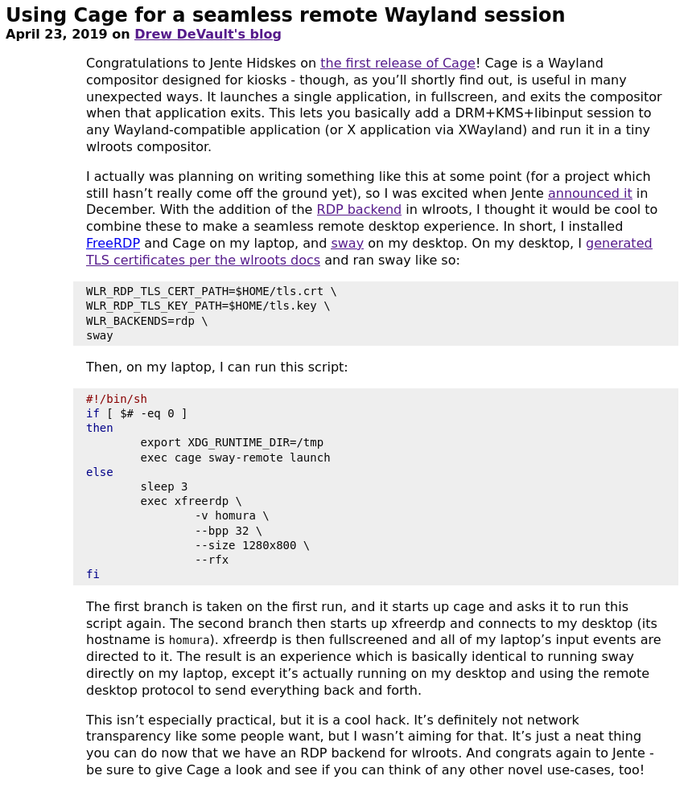
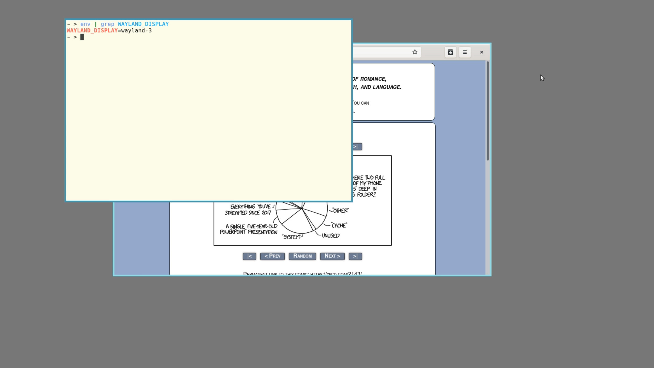
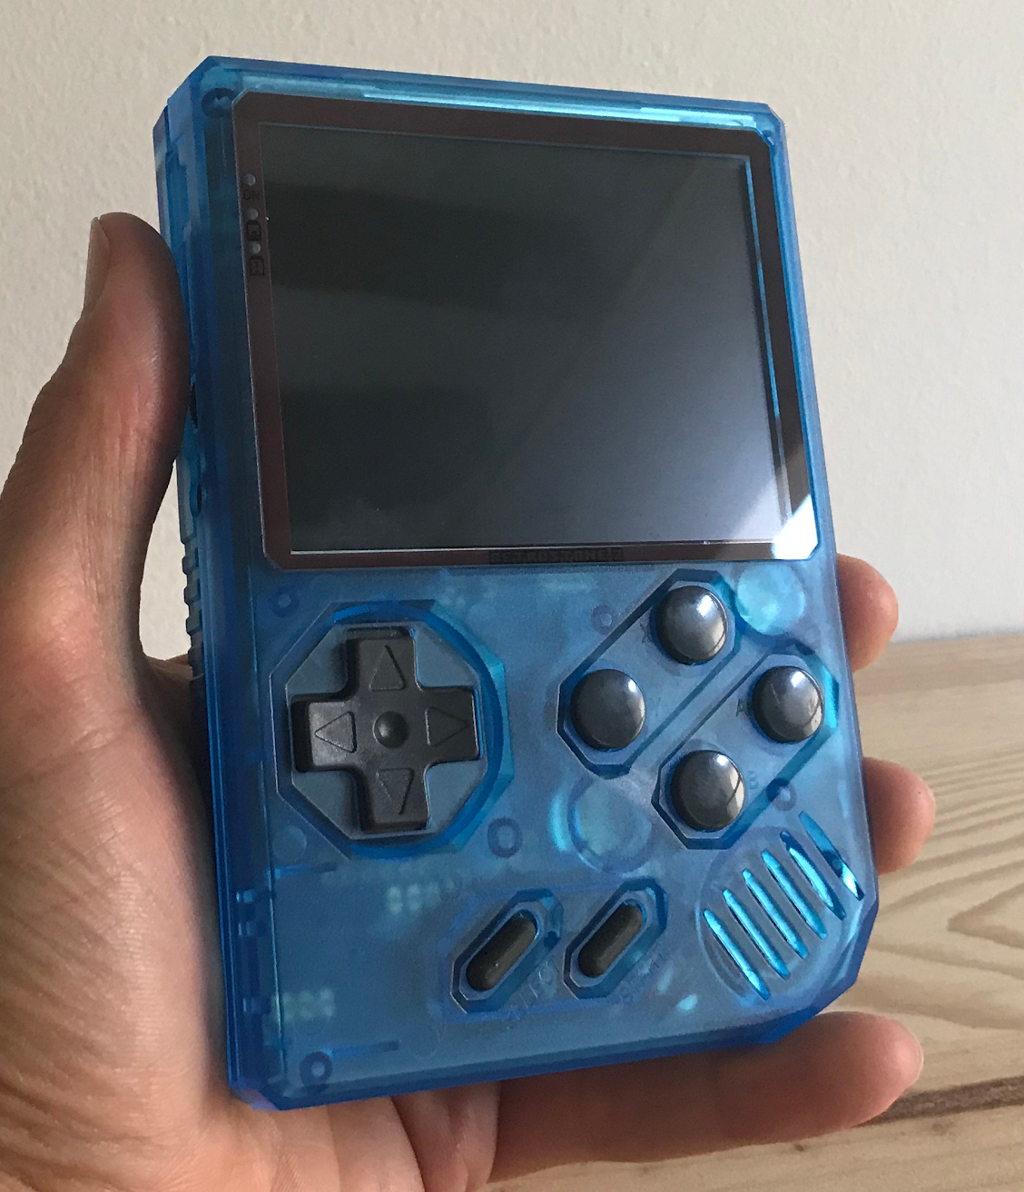
Cool things!
Notes:
For example, Cage has been used for a seamless remote Wayland session, in a clone of Plan 9's rio for Wayland and rumour has it some companies use it for their infotainment. It’s also used as the base for Cagebreak, a ratpoison inspired Wayland compositor.
Today, I am working with the people behind the RetroStone2 to provide Cage as their compositor.

Slide 5

Notes:
So, my priorities changed.
Cage is now the main focus and its scope has broadened significantly. It is no longer a simple kiosk with minimal support for what I need; it is slowly growing into a one-size-fits-all compositor for embedded devices.
I’ll get to my plan to take on this task in a bit.

Slide 6
Rewind time
Who am I?
What is Cage?
Plans for Cage’s future
Philosophy behind Cage
Agenda

Slide 7

Who am I?
Jente Hidskes Stockholm, Sweden Master of Science in Computer Science Software engineer in the streets, FLOSS contributor in the sheets
Notes:
My name is Jente Hidskes. I live in Stockholm in Sweden, but I was born and raised in Rotterdam in The Netherlands.
That over there isn’t really me by the way, but the avatar I’ve been using in the open source world. I think it’s cute. It’s also a link to my website if you’re curious.
My background is in computer science, where I’ve gotten my master’s degree from the Delft University of Technology.
In my day to day life I’m a software engineer using purely functional programming. In my spare time I like to contribute to the world of free and open source software, so I guess you could say I’m a software engineer in the streets and a FLOSS contributor in the sheets. My colleagues know though, so it’s not really a dirty secret.
For example, I used to maintain Piper and and am the original author of Gcolor3. In 2017, I participated in Google’s Summer of Code. I’ve also been a moderator at the Crunchbang Linux forums and was involved in the BunsenLabs continuation.
What I am not, is a graphics engineer. That’ll be a recurring point in this presentation. Half the time I have no clue what I'm doing, but I managed to create this awesome project that is actually used!

Slide 8

What is Cage?
Cage is
a Wayland compositor
for a kiosk-style user experience
Notes:
This isn’t a technical talk, so I won’t be going into too many details. If that’s what your after, reach out to me after the talk and I can point you to some resources.
That said, Cage is a Wayland compositor for kiosk-style user experience.
For the uninitiated:
A compositor is a piece of software that takes application’s window buffers and combines (“composites”) them into an image representing the screen and writes the result into the display memory. Or, in simple terms, it’s the software that draws things to your screen. In fact, Cage is running right now, but since it doesn’t draw anything of its own you don’t see it. Compositors may perform additional processing on buffers such as visual effects and can be used to take away visual glitches by applying e.g. double buffering. If this makes you think of window managers such as Compiz with its wobbly windows or xcompmgr, you’ve got it!
If a compositor is supposed to take application windows’ buffers and combine them, it needs to know certain things. For example, it needs to know when an application has updated its buffer and the compositor needs to redraw the buffer’s contents. The inverse if also true: say that the user has moved the mouse, then the compositor needs to be able to tell the client about this so that it could for example change the focused element. This sort of interaction goes over a previously established protocol that both the compositor and the applications speak. Wayland is one such protocol for applications to talk to the compositor. It’s meant as a simpler replacement for the dated X protocol with its X Window System implementation. The technical details behind X and Wayland and questions such as “Why use Wayland” aren’t the scope of this talk. However, it’s relevant to mention that in contrast to the X11 world where a compositor is a standalone client separate from the window manager, which in turn is separate from the display server; in Wayland a compositor is both the display server and the window manager.
So, Cage is a compositor (a piece of software that draws application windows to the screen) that talks with applications using the Wayland protocol. ”Kiosk” refers to the way the user is allowed to interact with the application whose windows are being managed by Cage.

Slide 9



What a kiosk?
Notes:
Have you ever been in a shopping mall and seen the large information displays so you can find what you’re looking for? Or have you ever been to the dentist and they have this iPad to ask you how you’re feeling? Or maybe a hotel lobby you’ve stayed at had an information display over the counter.
All of these are examples of devices that are called “kiosks” and they typically allow for a “kiosk-style” user interaction. What this means it that the system is designed for a user experience wherein user interaction and activities outside the scope of the running application are prevented. Often, this means that a kiosk compositor displays a single maximized application at a time and prevents the user from interacting with anything but this application.
This is what Cage does; it provides the user interaction part of the typical kiosk suite of tools. As I said, my original intentions were to have a Raspberry Pi with a touchscreen that would show Home Assistant’s control center. Since this was a special purpose system, I wanted to approximate that as good as I could and hence I started this Kiosk compositor (I can promise you it had nothing to do with the fact that a basic kiosk is super simple to make and would allow me to cut features…)
What I’ve learned since is that this generic kiosk-style interaction lends itself very well to broader use-cases as well! For example, Cage is an excellent example of functioning nested Wayland compositor as Drew showed with his Wio project. A simple, maximized-only compositor also fits very well for general infotainment displays, or home cinema setups that run for example Kodi. Or Game boy emulators, since they only need to show the running game and perhaps a statusbar. My most recent find, and the focus of my attention currently, is the fact that this style of interaction also fits very well with mobile phones. Think about it, an Android or iPhone most of the time shows a single, maximized application with a status bar.

Slide 10
Cage’s future
Different use-cases are the same, but different
One-size-fits-all compositor, but stick to kiosk-style roots
A set of plug and play abstractions, composed into “strategies”
Cage on phones!
Want to help? Reach out!
Notes:
So I started with a special purpose super minimal compositor that fulfilled my own needs, and then I found that I didn’t really need it at all. But at the same time, people were running with Cage and doing all kinds of cool tricks with it and I loved that! However, all these different uses are mostly the same in that they require the kiosk-style maximized window approach, but slightly different in the details. For example, running Cage as a nested compositor you’d want proxy requests for moving/resizing windows and sync the clipboard, whereas as a standalone compositor you don’t need these. Similarly, when running Cage as an actual kiosk you’d want it to exit when the application exits, but when running as a compositor on a mobile phone this might not be what you want.
So my goal is to accommodate these “same same” behaviours and turn Cage into a one-size-fits-all compositor for embedded devices. My plan for taking on this task is to provide a set of plug and play abstractions and multiple "strategies" that compose these components into a behavior suitable for a certain embedded environment.
At its core, Cage will stick to its ideals of the kiosk-style user interaction of only a single, maximized window at a time. But these strategies allow for example for the composition of different Wayland protocols that enable additional features, or different multi-monitor behaviours. For example, if you were to connect your RetroStone2 to a screen you’d want your contents to be displayed only on that screen, because a multi-screen setup with a gameboy makes little sense. Whereas if you for example use Cage in an infotainment setup, you might want to span the video over multiple screens.
I also found projects such as Purism’s Librem5 and Pine’s Pinephone and got hooked on the idea of making my own Linux phone environment (although this time I’ll try not to reinvent the universe!).

Slide 11
Philosophy behind Cage
I’m not a graphics engineer…
… yet I managed to create this awesome compositor!
Can I inspire you to do the same?
Or join me! Willing to mentor!

Slide 12
https://www.hjdskes.nl/
https://twitter.com/hjdskes
dev@hjdskes.nl

Slide 13

Finish
Thank You

